Slide 1
Maven – The Knowledge Sharing Platform Oracle Retail Solution Overview Day 3 (16th April 2012) Uday Pendyala

Slide 2
Agenda – Foundation Data
Organization Hierarchy
Organization Structure
Channels
Transfer zone/entities
Banner
State
Country
Location List
Location Traits
Organization Hierarchy
Store
Store Address Type
Store Attributes
Warehouse
Currency
Exchange rate
Calendar
4-5-4 & Gregorian
Code Masters
System Options
Notes:
2

Slide 3
Foundation Data Calendar

Slide 4
Calendar
ORMS supports two types of calendar
Normal (Julian) Calendar
Retail (4-5-4) Calendar

Slide 5
Calendar
Normal (Julian) calendar
Results in uneven yearly, quarterly, and monthly comparisons since calendar dates generally fall on different days from one year to the next.
The number of weekdays differs from one year to the next. For example: There may be four Saturdays in a month one year, but five Saturdays the next year.

Slide 6
Retail 4-5-4 Calendar
Each quarter contains 13 full weeks divided into a 4-5-4 format
The 4-5-4 Retail Accounting Calendar divides the year into quarters with the first and last month of each quarter consisting of 4 weeks each and the middle month of each quarter consisting of 5 weeks
Each accounting calendar month will begin on a Sunday and end on a Saturday
Each accounting calendar month will have the same number of selling days as the same month last year. For example, March has 5 perfect weeks every year, 5 Saturdays, 5 Mondays, etc
The number of days in the retail year, except leap year, equals only 364 days.
To compensate for the missing day in non-leap years, an extra week is added to the calendar once every seven years.

Slide 7
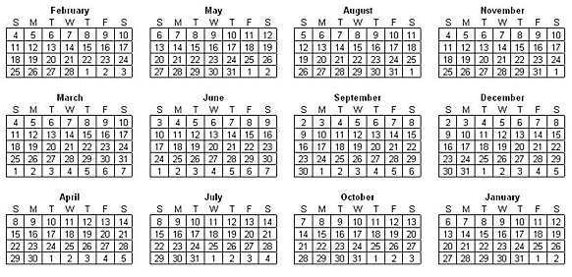
Calendar - Sample 4-5-4 Retail Calendar

Slide 8
Retail Calendar
Pro
Accurate sales comparison
Historical sales trend analysis can be done
Weekly targets/OTB can be maintained and monitored
Sales history tracked daily, weekly and monthly
Cons
Organization Process Change/mindset change
Month begin or end dates are different from normal calendar month.
Workaround to post month end processing to sync the financial calendar in Oracle Financials

Slide 9
Normal Calendar
Pro
Simple approach
No process change
Easy integration with the Oracle financial system
No weekly targets/OTB can be maintained or monitored
Cons
Results in uneven sales comparison
Uneven historical sales trend analysis
Sales History Tracked monthly

Slide 10
Calendar System Options
System Option | Description | Optional Settings | Effects
4-5-4 or Gregorian Calendar Indicator (CALENDAR_ 454_IND) | Determines if a 454 or Gregorian calendar will be used. | 4,C 4 = 454 C = Gregorian Calendar | Flows to other systems. If the Gregorian calendar is chosen, the retailer cannot plan by week or view a weekly roll-up of the stock ledger. If it is set to 454 there are some alternative tables to view transactions rolled-up by Calendar Month in RDW (Gregorian)

Slide 11
Foundation Data Organization Hierarchy

Slide 12
Foundation Data: Organization Hierarchy
Structure established in ORMS that is required to support the operational structure of a company
A hierarchical grouping mechanism for organizational levels and “stores” reflecting financial accounting structure
One to many relationships
Allows the customer to define the names for each level of the hierarchy
ORMS supports 6 levels
Warehouse can be associated at any level of the hierarchy
Company
Chain
Area
Region
District
Store
Warehouse

Slide 13
Foundation Data: Organization Hierarchy
Each level can be assigned to an individual responsible, for that area of the business
Flexibility exists so retailers can define levels by:
geography
business type
Reporting can be done at all levels of the organizational hierarchy
Company
Chain
Area
Region
District
Store
Warehouse

Slide 14
Foundation Data : Organization Hierarchy
Path: Action>Organization Hierarchy

Slide 15
Determining Organization Hierarchy
Financial Books
Existing Organizational levels
Future Growth
Stable hierarchy
Management Structure
KPI & Reporting

Slide 16
Organization Hierarchy: Level 1 Company
LSIPL
Highest level of the organizational hierarchy
Only one company per instance of Oracle Retail
Shared by both the organizational and merchandise hierarchies
Company
Chain
Area
Region
District
Store
Warehouse

Slide 17
Organization Hierarchy: Level 2 Chain
LSIPL
Typically used to distinguish brands or trading names within a company
The application allows up to 9999 chains
Chain attributes:
Description (free form text)
Manager name (free form text)
Currency (used for reporting)
Max
Lifestyle
LMG Brands
Company
Chain
Area
Region
District
Store
Warehouse

Slide 18
Organization Hierarchy: Level 3 Area
LSIPL
Typically used to define a geographical grouping within a chain
An area will only belong to one chain
The application allows up to 9999 areas
Area attributes:
Description (free form text)
Manager name (free form text)
Currency (used for reporting)
Location traits
Max
Lifestyle
LMG Brands
India.
EMEA
Company
Chain
Area
Region
District
Store
Warehouse

Slide 19
Organization Hierarchy: Level 4 Region
LSIPL
Typically used to define a geographical grouping within an area
A region will only belong to one area
The application allows up to 9999 regions
Region attributes:
Description (free form text)
Manager name (free form text)
Currency (used for reporting)
Location traits
Max
Lifestyle
LMG Brands
India.
EMEA
Company
South
West
Chain
Area
Region
District
Store
Warehouse

Slide 20
Organization Hierarchy: Level 5 District
LSIPL
Typically used to define a geographical grouping within a region
One district will only belong to one region
The application allows up to 9999 districts
District attributes:
Description (free form text)
Manager name (free form text)
Currency (used for reporting)
Location traits
Max
Lifestyle
LMG Brands
India.
EMEA
Company
South.
West
Chain
Area
Chennai
Bangalore
Region
District
Store
Warehouse

Slide 21
Organization Hierarchy: Level 6 Store
LSIPL
Defines the physical retail location
Level at which all business transactions occur:
Sales, Returns, Receipts, Transfers, Adjustments, Cycle Counts
Store must be associated with a channel in a multi- channel environment
One store will only belong to one district
The application allows up to 9,999,999,999 stores ( up to 10-digits locations)
Multiple addresses can be defined for stores and warehouses
Max
Lifestyle
LMG Brands
India.
EMEA
Company
South.
West
Chain
Area
Chennai
Bangalore
Region
District
Mantri
Oasis
Store
Warehouse

Slide 22
Organization Hierarchy: Level # Warehouse
LSIPL
Defines a physical storage, cross-dock, and/or distribution facility
Level at which business transactions occur, except sales (Issues)
Can be optionally tied to any level of the organizational hierarchy for reporting
Activity schedule for shipping and receiving can be defined
The application allows up to 9,999,999,999 warehouses
Multiple addresses can be defined for stores and warehouses
Max
Lifestyle
LMG Brands
South
West
Company
KAR
TN
Chain
Area
Mangalore
Bangalore
Region
District
Mantri
Oasis
Hoskote
Store
Warehouse
Notes:
Pending decision is on Chain level

Slide 23
Foundation Data Multi Channel

Slide 24
Foundation Data : Multi-Channel & Banner
Multi-Channel
The multi-channel business structure is prevalent in today’s retail environment
Combination of brick and mortar stores, web stores and catalog sales channels
Retailers need to track the profitability of each channel.
To support profitability metrics, sales and inventories must be isolated by channel
ORMS supports the segregation of sales and inventory by channel for both stores and warehouses
ORDW allows for reporting at the channel level
Banner
Banners are used to distinguish one area of business or corporation from another outside organization hierarchy.
Multiple channels can be associated with one banner

Slide 25
Example
Traditional Multi-Channel
Brick &
Mortar
Catalog
E-Store
Segregate by Concept
Primary
Stores
Kids
Stores
Primary
Catalog
Kids
Catalog
Use for Inventory Segregation for Single-Channel Retailer
Regular
Orders
Investment
Buy
Promotions

Slide 26
Foundation Data : Multi-Channel
What makes an ORMS installation multi-channel?
If there is any possibility multi-channel will be used, should be set up at install
If install is multi-channel, a channel must be selected for each store and warehouse, BUT can be changed over time.

Slide 27
Foundation Data : Multi-Channel
Store Channel Field – For Multi Channel
Associates the store to a channel
The key difference between a brick and mortar selling location and web store/catalog channel:
A web store/catalog does not stock inventory; instead they send all items bought from the website/catalog direct to consumer from a central warehouse
Brick & Mortar Stores are selling/stocking locations,
When setting up a Store, it will be classified as “stock holding or “non-stock holding” location
Warehouse Channel Field – For Multi Channel
Associate Virtual warehouse to a channel
Virtual warehouse are associated to Physical warehouse
All the transaction are done at Virtual Warehouse

Slide 28
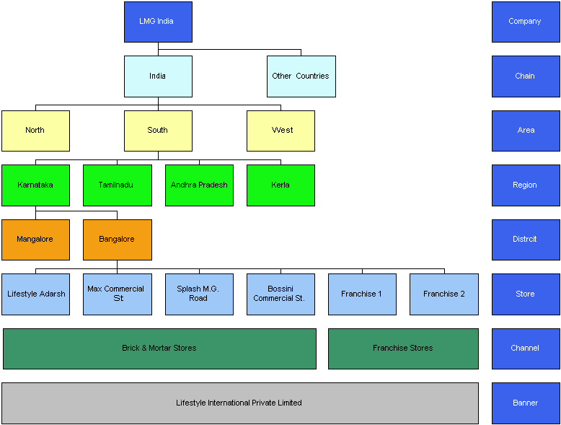
Organization Hierarchy Diagram - Example

Slide 29
Organisation Hierarchy: System Options
System Option | Description | Optional Settings | Effects
Organizational Hierarchy System of Record Indicator | Indicates whether RMS is the System of Record for organizational hierarchy information. This is a required data element and valid values are Y or N. | Y, N | If this value is set to “N” users can only View the organizational hierarchy information. If this value is set to “Y” users will have the capability to Create, Edit & View.

Slide 30
Multi Channel: System Options
System Option | Description | Optional Settings | Effects
Multi-Channel Indicator | Indicates whether the Oracle Retail multi-channel feature is turned on. | Y, N | If the is “N” The channel feature will not be used and virtual warehouses will not exist If this is “Y” The multi-channel feature will be used and at least 1 virtual warehouse needs to be created for every physical warehouse

Slide 31
Foundation Data Transfer Entity & Zones

Slide 32


Foundation Data : Transfer Entity
Regular Stores
Outlet Stores
Control -> Setup -> Transfer Entities
Transfer entities define which locations in an organization are grouped together due to legal requirements.
Moving items between transfer entities is created as inter company transfer in the system and recorded with different tran codes other than the Intra company transfer.

Slide 33

Foundation Data : Transfer Zone
Transfer zones are created to limit store to store transfers to keep cost down
Store-to-Store
NEVER Allowed
South Zone
Stores
West Zone
Stores

Slide 34

Combining
Regular Stores Entity
Outlet Stores Entity
South
Transfer Zone
West
Transfer Zone

Slide 35
Store Setup
South Zone
West Zone
Regular
Outlets
Each Store is independently associated with a Transfer Entity & a Transfer Zone

Slide 36

Warehouse Setup
Non Multi-Channel Setup
The physical warehouses are associated to the transfer entity.
Regular
Outlets
Multi-Channel Setup
Virtual warehouses are associated to the transfer entity.
The same physical warehouse can serve two entities or two channels.
B & M
E-Stores
B & M
Regular
Outlets

Slide 37
System Options – Transfer Entity
System Option | Description | Optional Settings | Effects
Intercompany Transfer Indicator | Indicator to tell if the intercompany transfers will occur. If this is turned to “Y” then each location will need to be associated to a transfer entity. | Y, N | Y – The transfer entity functionality will be enabled. All stockholding warehouses and all stores will have to be associated to an entity. N – The transfer entity feature will not be enabled.

Slide 38
Foundation Data Location List & Traits

Slide 39



Organization Hierarchy-Location Traits
Allows for the grouping of stores with unique characteristics
Stores of a particular business type
Urban Stores
New Concept Store
Walk-through Stores

Slide 40
Location Traits
Common Features
Flow to RDW
Defined by the Retailer
Used in
Reporting
Assist in Creation of Location Lists
Can also be used in custom interfaces to 3rd party systems as a decision making reference point.
Re-Use for Maintenance Updates
Traits can be assigned at the Area, Region, District as well as store level

Slide 41



Location List
Grouping of locations based on characteristics defined by the user
‘Static Indicator' if checked, list has to be created manually.
‘User Security Ind’ if checked, only the user who created the location list can edit it.
Replenishment,
Stock Counts,
Mass Maintenance,
Reporting,
Other Apps, etc.

Slide 42
Location List - Attributes
Attribute | Description
Static Indicator | Determines if the List can be changed
Batch Rebuild Indicator | Determines if the list will be rebuilt during a batch run
User Security Indicator | Restricts the list to be changed by the user who created it.

Slide 43
Foundation Data Store

Slide 44






Store
Entity at which all business transactions occur
Sales & Returns, Receipts, Transfers, Adjustments, Cycle Counts, RTV’s
Can represent a non-physical location

Slide 45
Store Key Attributes
Attributes:
Default warehouse
Store open/close Dates
VAT Regions (value added tax)
Store attributes
Location traits
Addresses
Store start/stop order dates
Channel ID
Org Unit ID
Stock Holding Indicator
Company
Chain
Area
Region
District
Store
Warehouse

Slide 46
Store Key Attributes
Groupings:
Promotional zones
Regular Pricing zones
Clearance zones
Transfer zones
Store Class
Store grade groups
Location Lists
Company
Chain
Area
Region
District
Store
Warehouse

Slide 47
Store Activity Schedule
Defines the days that a store is open/closed for
Receiving
Shipping
Sales
Used by:
Replenishment
Sales Audit
Warehouse Management
Company
Chain
Area
Region
District
Store
Warehouse

Slide 48
Store Delivery Schedule
Associates each store with a day of the week on which the store can expect a shipment from the warehouse
Ship dates can be selected by:
Day of the week
Days within a specified date range
Specified date
Company
Chain
Area
Region
District
Store
Warehouse

Slide 49
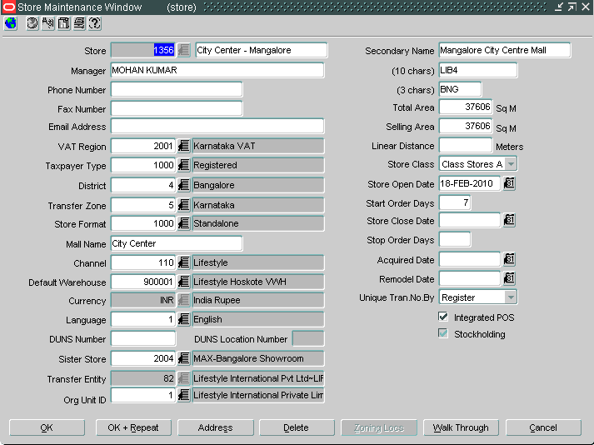
Creating the Store
Store ID created in RMS will have only 5 digits (numerical) as ORPOS can accept the same
Store ID will be created as per Oracle Apps Cost Centre Code
Contact Name, Phone number, address details of Store should be captured in the address screen and not in the main screen of Store creation
Tax related Information. Important for tax calculation
Store Formats
1000 – Regular
1001 – Franchisee (SOA) Integrated
1002 – Franchisee (SOA) Not Integrated
1003 – Franchisee (SOR) Integrated
1004 – Franchisee (SOR) Not Integrated
1005 – Wholesale
Attach District as per Org. Hierarchy
Attach Transfer Zone corresponding to the district. Store to store transfer will be restricted to the stores belonging to same transfer zone.

Slide 50
Creating the Store
Select the appropriate channel
Sister Store is used by Allocations to copy the stores history when defining allocations for new stores
Select the default virtual warehouse for the store. (System allows stock movement with other warehouses as well)
Transfer Entity to be selected as –
82 - Lifestyle International Pvt Ltd~LIFESTYLE INTL PVT LTD
83 - Max Retail~MAX RETAIL – DIVISION
Stock Transfer between locations of two different transfer entities is considered as Intercompany Transfer
Currency should the local currency where the store operates. For Indian operation, this will always be INR
Language to be selected as “English” always
Default Org. Unit ID, 1, to be selected

Slide 51
Creating the Store
Capture store size and class
Store Opening parameters
Start Order Days allows to create orders prior to store opening
Store closure parameters
Stop Order days will restrict creation of Orders to the store before closure
Transaction Nos will be unique by Store or Register
If the store is integrated with POS via ReSA
Indicates if the store is a physical stock holding location or not.
E-Store, Catalogue store etc. might be non stock holding locations

Slide 52
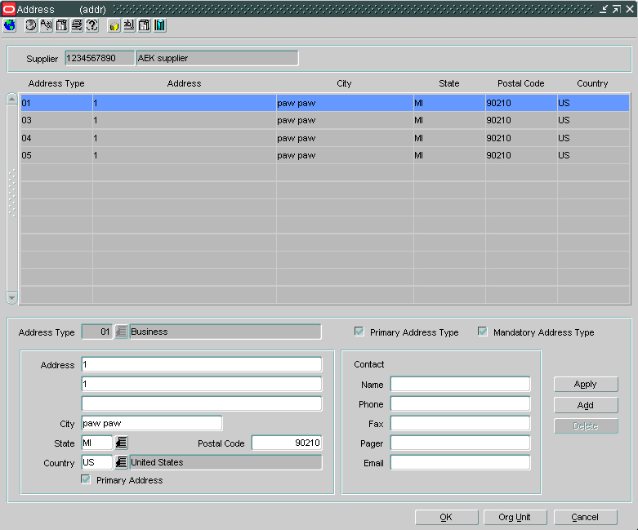
Address Type
01 - Business
02 - Postal
03 - Returns
04 - Order
05 -Invoice

Slide 53
Foundation Data Warehouse

Slide 54

Warehouse
Entity at which inventory transactions occur, except Sales
RTV’s, Receipts, Transfers, Adjustments, Cycle Counts
Distribution Center
Redistribution Center
Multi-Level Distribution Warehouses

Slide 55

Physical Vs Virtual
Inventory movement
Between virtual warehouses, no physical movement of the inventory is required.
“Book Transfer”
B & M
Catalog
E-Stores

Slide 56
Physical Vs Virtual
Ordering
Buyer Orders to the virtual warehouse.
EDI will roll-up the virtual warehouses to the physical warehouse for the supplier.
Replenishment & Forecasting
Virtual Warehouses can be setup as the system replenishment warehouse and have forecasts generated against them.
Supplier Deals
Location specific deals are setup and managed at the physical warehouse level.
Stock Counts & Inventory Adjustment
Results are initially prorated among the virtual warehouse(s).
Results can be redistributed (for Unit & Dollar Stock Counts)

Slide 57
WH System Options
System Option | Description | Optional Settings | Effects
Virtual Warehouse Distribution Rule | Indicates which distribution rule to use when the actual quantity to be distributed among virtual warehouses is different from the expected quantity. The valid values are stored on the RMS “Code” Tables. The values are on CODE_DETAIL with a code_type = ‘DRUL’ | PRORAT = Proration MN2MX = Minimum to Maximum MX2MN = Maximum to Minimum | The general rule of thumb with this one is to set it to PRORAT. With the other methods you can’t prioritize which virtual warehouse is selected first from the group. It is random.

Slide 58
Foundation Data Currency & Exchange Rate

Slide 59
Currency Date Flow Example
Exchange Rate
Source (Provider)
Financial
System
Oracle Retail
Merchandising
System
(RMS)
Point of Sale
RMS can either upload it or enter in manually
RTM, ReIM,
RDW, RPM

Slide 60

Basic Currency Types
Primary
Local
Supplier
Rs
€
Rs
£
£
Single unifying currency for corporate
Main Currency that Locations Operate in
The currency that is used for cost management and the DEFAULT currency for Orders & Deals

Slide 61

Where the Types are Used
Action | Currency
View Sales | Local & Primary
View Individual Transactions | Local
View Stock Ledger¹ | Local & Primary
Create PO’s | Any (Defaults to Supplier)
Plan | Local & Primary
Manage Price | Local & Primary
Manage Cost | Supplier
Supplier Deal Management | Any (Defaults to Supplier)
Audit Store Sales | Local
If the Primary & Local Currency are the same, there will still only be 1 record (local currency) on the tables.
Reporting

Slide 62



Base Exchange Rate Types
Consolidated
Determined
Setup Ahead of Time
Used
Operational
Current
Used
Notes:
Consolidated & Operational
In RMS, the retailer must pick to be either a consolidated or operational for all currencies (SYSTEM setting). They must have an exchange rate for either one, depending on the setting.
Consolidated – Generally agreed upon exchange rate that will be used for the period (generally monthly). Assists in planning as currency fluctuations are lessened.
Operational – Generally the business will operate according to the daily exchange rate.

Slide 63

Ordering
1
2
Currency Setup
Creating an Order to the Location
Primary
Order in Hong Kong Dollars
Inventory Value at Location is Stored in Korean Won
Indian Rupee
Supplier
3
Currency Conversion Path
Hong Kong $
Location
Hong
Kong $
Indian
Rupee
Korean
Won
Korean Won

Slide 64
Currency System Options
System Option | Description | Optional Settings | Effects
Consolidation or Operational Indicator | This is the indicator to tell if the retailer will be using the consolidated or operational currency exchange. | Y, N | If Y, the consolidated exchange rates will be used. If N, the operational.
Primary Currency | The primary currency of the retailer. | Based on Currency Code in Currency Table | Sets the primary currency for the Merchandising Products

Slide 65
Currency, System Options – Con’t
System Option | Description | Optional Settings | Effects
Multi-Currency Ind | This indicates whether or not the multi-currency feature will be supported. | Y,N | If multi-currency is not supported, suppliers STILL can have a different currency than the primary currency. If multi-currency is on the stock ledger will be calculated in both primary and local. If primary and local are the same, there will still be two records

Slide 66

"How do you know so much about everything? was asked of a very wise and intelligent man; and the answer was By never being afraid or ashamed to ask questions as to anything of which I was ignorant.“
- John Abbott

Slide 67
Thank You

